Slide 1
Deadlock and Starvation
Lecture 2 of 2
  Deadlock Detection and Recovery approaches
  Deadlock Prevention - The Bankers Algorithm
The Dinning Philosophers Problem
Note: Examples of the concepts presented here can be found in the RTExamples folder: Q12
You are encouraged to open the project in Visual Studio and run the program
©Paul Davies 2020. Not to be copied, used, or revised without explicit written permission from the copyright owner. This lecture may contain animations and is best viewed as a slide show

Slide 2
Strategy 3 - Deadlock Detection and Recovery
Detection and recovery allows deadlock to arise in a system, but uses the OS to break it. This scheme is rarely used in real-time, embedded systems due to safety and timing concerns.
Here, the OS record processes and their resource allocation/requests as an internal data structure (a directed graph as we saw in the last lecture),
With each resource allocated the OS subsequently checks for any circular dependency loops indicating a deadlocked system (see last lecture)
The OS could then recover in one of three ways:-
  Through Pre-emptive resource take back.
  Through Process Roll-back.
  By Killing processes.

Slide 3
Deadlock Recovery : Pre-emptive Take Back
Here the OS forcibly takes back a resource from a process to give it to another, breaking the circular dependency in the graph.
Some OS’s can do this automatically. In others, manual intervention may be required. For example, taking away a printer means the printing has to be done later – a minor inconvenience.
It may also be possible for the OS to provide an alias or “offline” version of the resource taken back. This would allow the process to continue, in which case the “offline” resource stores all the operations performed on it, which are then applied to the real resource when it becomes free.
However, there is no guarantee that the resource, will be in the same state later thus continuation may not be possible is not suitable for all resources.
For example working with an offline copy of a database is not a good idea. For example, if you made a holiday reservation but find later, when you reconnect, that the real holiday has been booked by someone else, there is little that can be done to correct the situation.

Slide 4
Deadlock Recovery : Roll Back
Here, a program can be written to anticipate deadlock and arrange to issue checkpoints or snapshots of the programs status at periodic intervals, (usually just before requests are made to acquire resources).
If the resource is taken away by the OS to break deadlock, that process could ‘rewind’ to an earlier state and attempt to repeat the operation(s).
Note that rollback is a complex procedure that may involve undoing previous actions that were successful at that time. This in turn can lead to further deadlock as the system tries to re-acquire them in order to roll them back.
Rollback is frequently employed in database systems and e-commerce applications e.g. web-based, where transactions on several databases may need to be carried out simultaneously (i.e. possibility of deadlock could arise).
Example Deadlock rollback in mySQL Database - see
https://blog.marceloaltmann.com/forcing-deadlock-rollback-victim-transaction-pt-forcando-transacao-vitima-de-rollback-em-deadlock/

Slide 5
Deadlock Recovery : Killing a Process
This is a brute force method whereby a process is killed, releasing all its resources and breaking the circular dependency that gave rise to deadlock.
With careful choice of ‘victim’ a deadlocked processes could continue.
It is best to kill a process that can be re-started from the beginning without any adverse affects, something like a compiler.
Killing a database or e-commerce application makes life difficult as it may have performed actions on a resource that may be difficult to restart later!!

Slide 6
Strategy 4
Deadlock Prevention
–
The Bankers Algorithm

Slide 7
Deadlock Prevention: The Banker’s Algorithm
The final approach involves prevention of deadlock in the first instance.
Note that Prevention is not the same as Avoidance.
With avoidance the programmer ensures at design time that it is not possible for deadlock to occur at run time.
With prevention, the OS ensures that deadlock cannot arise.
The bankers algorithm is rarely used in real-time embedded systems due to the small number of fixed processes and shared resources which means deadlock can easily be avoided with careful programming (as per last lecture).

Slide 8
Dijkstra (of Semaphore fame) came up with the Bankers algorithm after studying the way a bank manager deals with groups of customers that have been granted credit arrangements i.e. promises of loans of money.
In this analogy, the loans represent resources, the Bank Manager is the OS and Customers are the processes trying to acquire money, i.e. resources.
Limitations
The main limitation of this algorithm, is the fact that processes have to declare upfront, at they time they run, the number and type of each resource they are going to request (this is why it is not a universal solution).
Key Idea
The bankers algorithm is based upon the idea that an operating system will deny a process access to a resource, even if that resource is free, if the act of granting the resource could potentially, at some time in the future, lead to the formation of a circular dependency list, i.e. deadlock.
In essence the operating system prevents deadlock (i.e. running out of resources – or money in the case of the bank manager) by always maintaining itself in a safe state where deadlock cannot happen.

Slide 9
Bankers Algorithm - Safe and Unsafe States
A safe state exists when there are sufficient free resources within the system (at that time) for it to be possible for each process to acquire, in some special order, all the resources each needs to complete its task and afterwards, release them.
An unsafe state is one where there may temporarily be insufficient free resources to allow the processes to acquire all the resources each needs in order to complete its task, thus deadlock could (but may not, depending upon the timing of those requests) arise in the future.
As each process requests resources, the system will only grant the resource if it leaves the system in a safe state afterwards.
If the system starts off in a safe state this algorithm ensures it will always remain in a safe state and deadlock will be prevented.

Slide 10
The Banker’s Algorithm – an Example and Explanation
Imagine a banker (our operating system) has agreed with several customers (our processes) that they can acquire certain sums of money (i.e. resources) which must be returned some time in the future when they have finished.
Let’s assume the banker has 4 customers, A, B, C and D and that in principle the following loan arrangements totaling $22k have been agreed.
  Customer A can borrow $6,000
  Customer B can borrow $5,000
  Customer C can borrow $4,000
  Customer D can borrow $7,000
That is, each customer has declared in advance the money he/she needs and the assumption/worst case is that at some point each will need it all.
Now if the banker had $22k in the vault, there would be no problem and we wouldn't need this lecture, since it’s obvious all customers could simultaneously acquire all the money they need without the bank running out, or customers having to compete for it.

Slide 11
The Banker’s Algorithm – an Explanation (cont…)
The fundamental problem however is the fact that the bank doesn’t actually have $22k to lend. Let’s suppose it only has $10k .
In our computing analogy, this is equivalent to saying that an operating system only has 10 resources, but that processes A, B, C and D might actually want 22 if they all requested their agreed resources at the same time.
Thus the potential for deadlock exists, which may or may not happen depending upon the actual timing of process requests for those resources.
By analogy, there is the potential for the Bank to run out of money and a customer cannot complete their business without it, so they would be unable to repay it either.
Given at the outset the bank has $10k and that the largest agreed loan is $7k (customer D), the system starts off in a safe state, since any customer could ask for and be given all the money he/she needs without the bank running out.

Slide 12
Implementing The a Simple Banker’s Algorithm
So how does a real bank ensure that it maintains itself in a safe state? What algorithm does the bank manager use?
When a customer requests some of their loan, the bank manager only permits the loan, provided the bank would be left with enough money to meet the remainder of that customers needs in the future (remember, customers agree a maximum loan with the bank in advance).
This means the bank manager only has to look at the current customer’s loan agreement and count the money in the vault, to figure out whether the bank will remain in a safe state after the loan to that customer is made.

Slide 13
An Example
Let’s start our simulation when the bank opens on Monday morning.
No customers have actually borrowed any money yet.
This is shown in Fig (a) below where the bank can satisfy any single customer request for their full loan entitlement as it has $10k free. This is thus a safe starting state, since any 1 customer could receive some or all of their loan amount which they will repay later.
Let’s see how the bank manager deals with customers arriving at the bank at various times during the day requesting some or all of their agreed loan, (by analogy how an OS deals with processes requesting resources at various times)
Has
Max
Starting point, bank can lend each customer their full agreed amount
A | 0 | 6
B | 0 | 5
C | 0 | 4
D | 0 | 7
Free $10k
Fig (a)

Slide 14
Applying Simple Bankers Algorithm
Granted as this leaves $8k and A could ask for $4k more.
Granted as this leaves $3k and C could only ask for $1k more.
Has
Max
Has
Max
Has
Max
A | 0 | 6
B | 0 | 5
C | 0 | 4
D | 0 | 7
Request $2k
A | 2 | 6
B | 0 | 5
C | 0 | 4
D | 0 | 7
A | 2 | 6
B | 2 | 5
C | 0 | 4
D | 0 | 7
Request $2k
Starting point, bank can lend each customer their full agreed amount.
Request $3k
Free $10k
Free $8k
Free $6k
Fig (a)
Fig (b)
Fig (c)
Granted as C now has it’s full entitlement and could return it.
Granted as this leaves $6k and B could ask for $3k more.
Has
Max
Has
Max
Has
Max
Has
Max
A | 2 | 6
B | 2 | 5
C | 3 | 4
D | 0 | 7
Request $1k
A | 2 | 6
B | 2 | 5
C | 3 | 4
D | 0 | 7
A | 2 | 6
B | 2 | 5
C | 4 | 4
D | 0 | 7
A | 2 | 6
B | 2 | 5
C | 0 | 4
D | 0 | 7
Request $1k
Release $4k
Request $1k
Free $3k
Free $3k
Free $2k
Free $6k
Fig (d)
Fig (e)
Fig (f)
Fig (g)
Both Refused (temporarily) even though the bank has the money as each would only leave $2k, i.e. not enough to satisfy A which could ask for a further $3k or D which could ask for a further $6k.
Who would be allowed to borrow money now? Can you see a way back to the starting point (all processes got what they agreed and returned it)?

Slide 15
Let’s see what could happen if the banker/OS simply granted a request because the money was available). Consider the resource allocations below from previous page.
Has
Max
Has
Max
Has
Max
Has
Max
A | 2 | 6
B | 2 | 5
C | 3 | 4
D | 0 | 7
Request $1k
A | 3 | 6
B | 2 | 5
C | 3 | 4
D | 0 | 7
A | 3 | 6
B | 2 | 5
C | 3 | 4
D | 1 | 7
A | 3 | 6
B | 3 | 5
C | 3 | 4
D | 1 | 7
Request $1k
Request $1k
Free $3k
Free $2k
Free $1k
Free $0k
Fig (d)
Fig (e)
Fig (f)
Fig (g)
Granted because there is $3k in the vault.
Granted because there is $2k in the vault.
Granted because there is $1k in the vault.
No money left, system is now on the verge of deadlock as there is insufficient money left for anybody to borrow the remainder of their agreed loan. When any customer requests further money, each will be blocked and ultimately, when they are all blocked, we have actual deadlock.
Whether deadlock arises depends upon the actual timing of the loans made to each of the customers, and their repayment of that money. Just because it could happen does not mean that it will, but it might (as we see above) and it is the possibility of deadlock arising that the bankers algorithm is designed to prevent.

Slide 16
Question: Should the Bank consider other customers loan agreements?
What would happen if the bank gave out the money, provided at least one of the other customers could still get their full loan – Would that prevent deadlock?
NO - Consider the snap shot below (for illustrative purposes, assume a different amount of money in the vault and different customer loan agreements).
Has
Max
Has
Max
Has
Max
Has
Max
A | 0 | 6
B | 0 | 6
C | 0 | 1
D | 0 | 6
Request $4k
A | 4 | 6
B | 0 | 6
C | 0 | 1
D | 0 | 6
A | 4 | 6
B | 4 | 6
C | 0 | 1
D | 0 | 6
A | 4 | 6
B | 4 | 6
C | 0 | 1
D | 3 | 6
Request $4k
Request 3k
Free $12k
Free $8k
Free $4k
Free $1k
Fig (a)
Fig (b)
Fig (c)
Fig (d)
If granted that would leave $8k in the vault which would be enough to meet A,B,C or D’s future needs.
If granted that would leave $4k in the vault which would be enough to meet A, B or C’s future needs.
If granted that would leave $1k in the vault which would be enough to meet C’s future needs.
The only process that could gain all it’s future agreed loan now is Process C needing $1K. However, if it were to get it’s $1k and return it, then there would still only be $1k in the vault which is not enough for anyone else’s future needs. Any money that A, B or D asks for is likely to lead to deadlock, although the system is not yet deadlocked.

Slide 17
Has
Max
Homework Problem: Here is a snapshot of the banks current status, where it has $2K in the vault. Apply the bankers algorithm. Which customer can borrow money and how much can they borrow at a time?
Play out some random scenarios whereby customers A, B, C, or D request varying amounts of their remaining loan in a random order and see who is permitted or temporarily denied access to their money before eventually returning them to the free ‘pool’.
Assume that once a process has completed, it does not borrow money again (would it matter if it did?)
A | 2 | 6
B | 3 | 5
C | 0 | 6
D | 0 | 7
Free $2k

Slide 18
Thus far, we have assumed that all resources (in this case money) were equal and interchangeable. What if there were different types of resources, e.g. a process needed to acquire 2 instances of resource R₀ plus 3 instances of resource R₃ etc. How does the bankers algorithm apply to this situation?
R₀
R₁
R₂
If there were 10 of each of the resources R₀ -R₂ at the start, play out similar scenarios to that of the previous page.
Remember, the Bankers algorithm always ensures that when a process requests any resources, it will only be granted, provided there are enough resources left to satisfy that customers full agreed resource amount.
(see tutorial question on Canvas)
Has
Max
Has
Max
Has
Max
A | 0 | 2 | 0 | 6 | 0 | 3
B | 0 | 5 | 0 | 5 | 0 | 5
C | 0 | 3 | 0 | 4 | 0 | 6
D | 0 | 8 | 0 | 7 | 0 | 8

Slide 19
Limitations of the Banker’s Algorithm
The bankers algorithm works well in some areas of programming, particularly batch programming, but in interactive or real-time systems, where processes are created in response to users logging in or events triggering the creation of new threads (which may request resources), it cannot be employed safely and the risk of deadlock will continue.
Furthermore, temporarily refusing process’s request for a resource (even when it is free), could lead to a non-deterministic system response.
Deadlock Summary
In summary there is no generic solution to solving deadlock. Each situation has to be analysed and the most appropriate scheme adopted to minimise the risk of its occurrence.
Sometimes that means the Ostrich algorithm might actually be the best (as well as the simplest) !!!

Slide 20
The
Dinning Philosophers
Problem

Slide 21
Introduction
While computer scientists were wrestling with the solution to deadlock back in the 70’s, Dykstra proposed a fictitious problem which could be used as the basis of evaluating each scientist’s solution. The problem involves one of potential deadlock and/or starvation.
The problem has become known as the “Dinning Philosophers Problem” for reasons that will become apparent. A solution to it, used to tax the brains of many an undergraduate Computer Scientist’s understanding of the subject.
These days much of the fun of setting this as a problem has been negated by the fact that its solution now appears in books on operating systems (you won’t be expected to remember it for this course). There’s some example solutions to it in the RTExamples folder on Canvas.

Slide 22
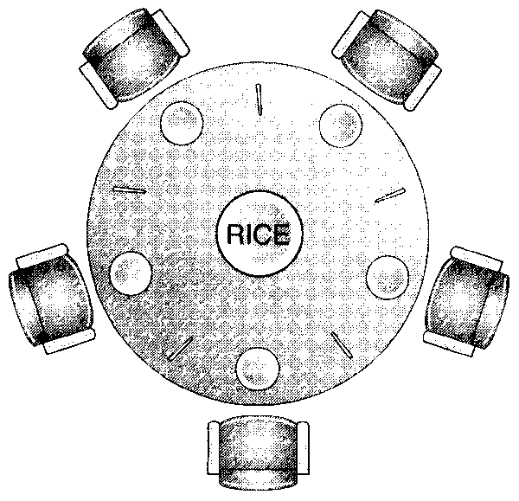
The Dinning Philosophers Problem
The original problem concerned five philosophers who sat around a circular table. Each philosopher has their own rice bowl and access to two chopsticks which are shared with the philosopher’s neighbours. The chopsticks are the resources that each philosopher competes to acquire.
The life of a philosopher consists of alternate bouts of eating, for which two chopsticks are needed, and thinking which requires none. The problem here is one of both deadlock and starvation.
If all philosophers decided to eat at the same time and each picked up their left chopstick first, followed by their right, then deadlock will occur, ditto right followed by left.
If a philosopher picks up their left chopstick and finding their right chopstick is unavailable, he/she could put it down and try again later, but starvation might result in both cases. Lastly a philosopher could kill his neighbour to free up the chopsticks
See if you can apply any of the avoidance solutions suggested at the start of this topic to solving this problem w.r.t. ensuring deadlock does not happen while avoiding starvation, could you apply the bankers algorithm to this problem?

Slide 23
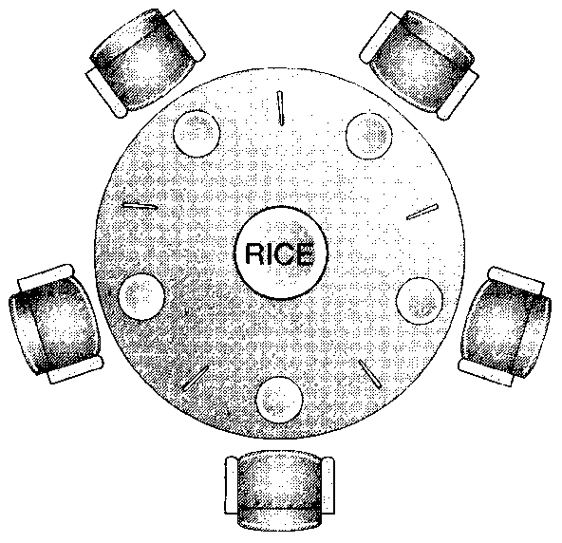
The Dinning Philosophers – A Solution
The solution presented in books is rather terse and cryptic and even though it is short, it is quite difficult to follow.
An example of it can be found in the rt.cpp library header file. Look for the class CDinningPhilosophers, while a working solution/implementation of it can be found in Q12 of the tutorial questions.
The textbook solution is not very good and is actually quite unrealistic since it involves a philosopher testing the state of his neighbour to see whether he is eating or not and hence deducing whether or not the chopsticks are free. This is unrealistic as threads cannot “see” or assume the existence of each other.
A more generic solution is actually a lot simpler and can easily be tailored to solving the dinning philosophers problem as well as other problems and makes use of a specific Win32 call (which other operating systems will have in some form or another) called the WAIT_FOR_MULTIPLE_OBJECTS().
It doesn’t avoid starvation, but it does avoid deadlock.

Slide 24
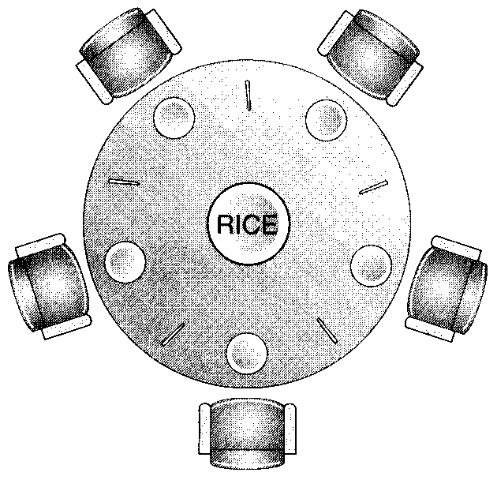
The Dinning Philosophers – A Solution (cont…)
The WAIT_FOR_MULTIPLE_OBJECTS system call in the Win32 kernel simply allows a process/thread to request multiple resources simultaneously.
The kernel will ensure that the process/thread either gets all the resources it asks for, or none of them
This behaviour has similarities with the deadlock avoidance scheme discussed earlier, where multiple resources were treated as one single resource. Either a process/thread has them all, or it has none of them.
However this scheme has the flexibility that other processes/thread can still request a sub-set of those resources.
It does not however eliminate the possibility of starvation, as a process may never find all the resources it needs are free at the same time.

Slide 25
The Dinning Philosophers – A Solution
To demonstrate the use of the WAIT_FOR_MULTIPLE_OBJECTS call, imagine we have two separate resources, a scanner and a DVD Writer with their corresponding two mutexes to protect them, as shown below.
  CMutex ScannerMutex(……) ;
  CMutex DVDWriterMutex(……) ;
Now imagine a process wants to acquire both of these resources without the possibility of deadlock. It obviously has to wait for both of them to become free and thus we cannot acquire one and then the other sequentially, we have to acquire them both simultaneously. We could achieve this using the WAIT_FOR_MULTIPLE_OBJECTS call as shown below.
First a process creates an array of ‘HANDLES’ (these identify the mutexes protecting to the resources we want to acquire) in this case 2.
HANDLE MyResourceHandles[2] = {
ScannerMutex.GetHandle(), // get handle/ID of each mutex
DVDWriterMutex.GetHandle()
} ;

Slide 26
The Dinning Philosophers – A Solution
Having got the two handles to the two resources, a process now attempts to acquire them both with one single function call
WAIT_FOR_MULTIPLE_OBJECTS(
2, // number of resources to acquire
MyResourceHandles, // array of handles to those resources
INFINITE // try this length of time to acquire
) ;
Here, we give the function the array of handles to the resources we require and then tell it to acquire them for us. We have specified a time period of INFINITE meaning do not return until you have got them.
Once the function returns, we know that we have sole access to the two resources and that a Wait() operation will have been performed on the mutexes so that nobody else can acquire them.
Of course we still have to Signal() the two resource mutexes in the usual manner when we have finished with them.
Note however that the possibility of starvation still arises
See RTExamples Q13 - Deadlock using WaitForMultipleObjects solution

